Slide 1
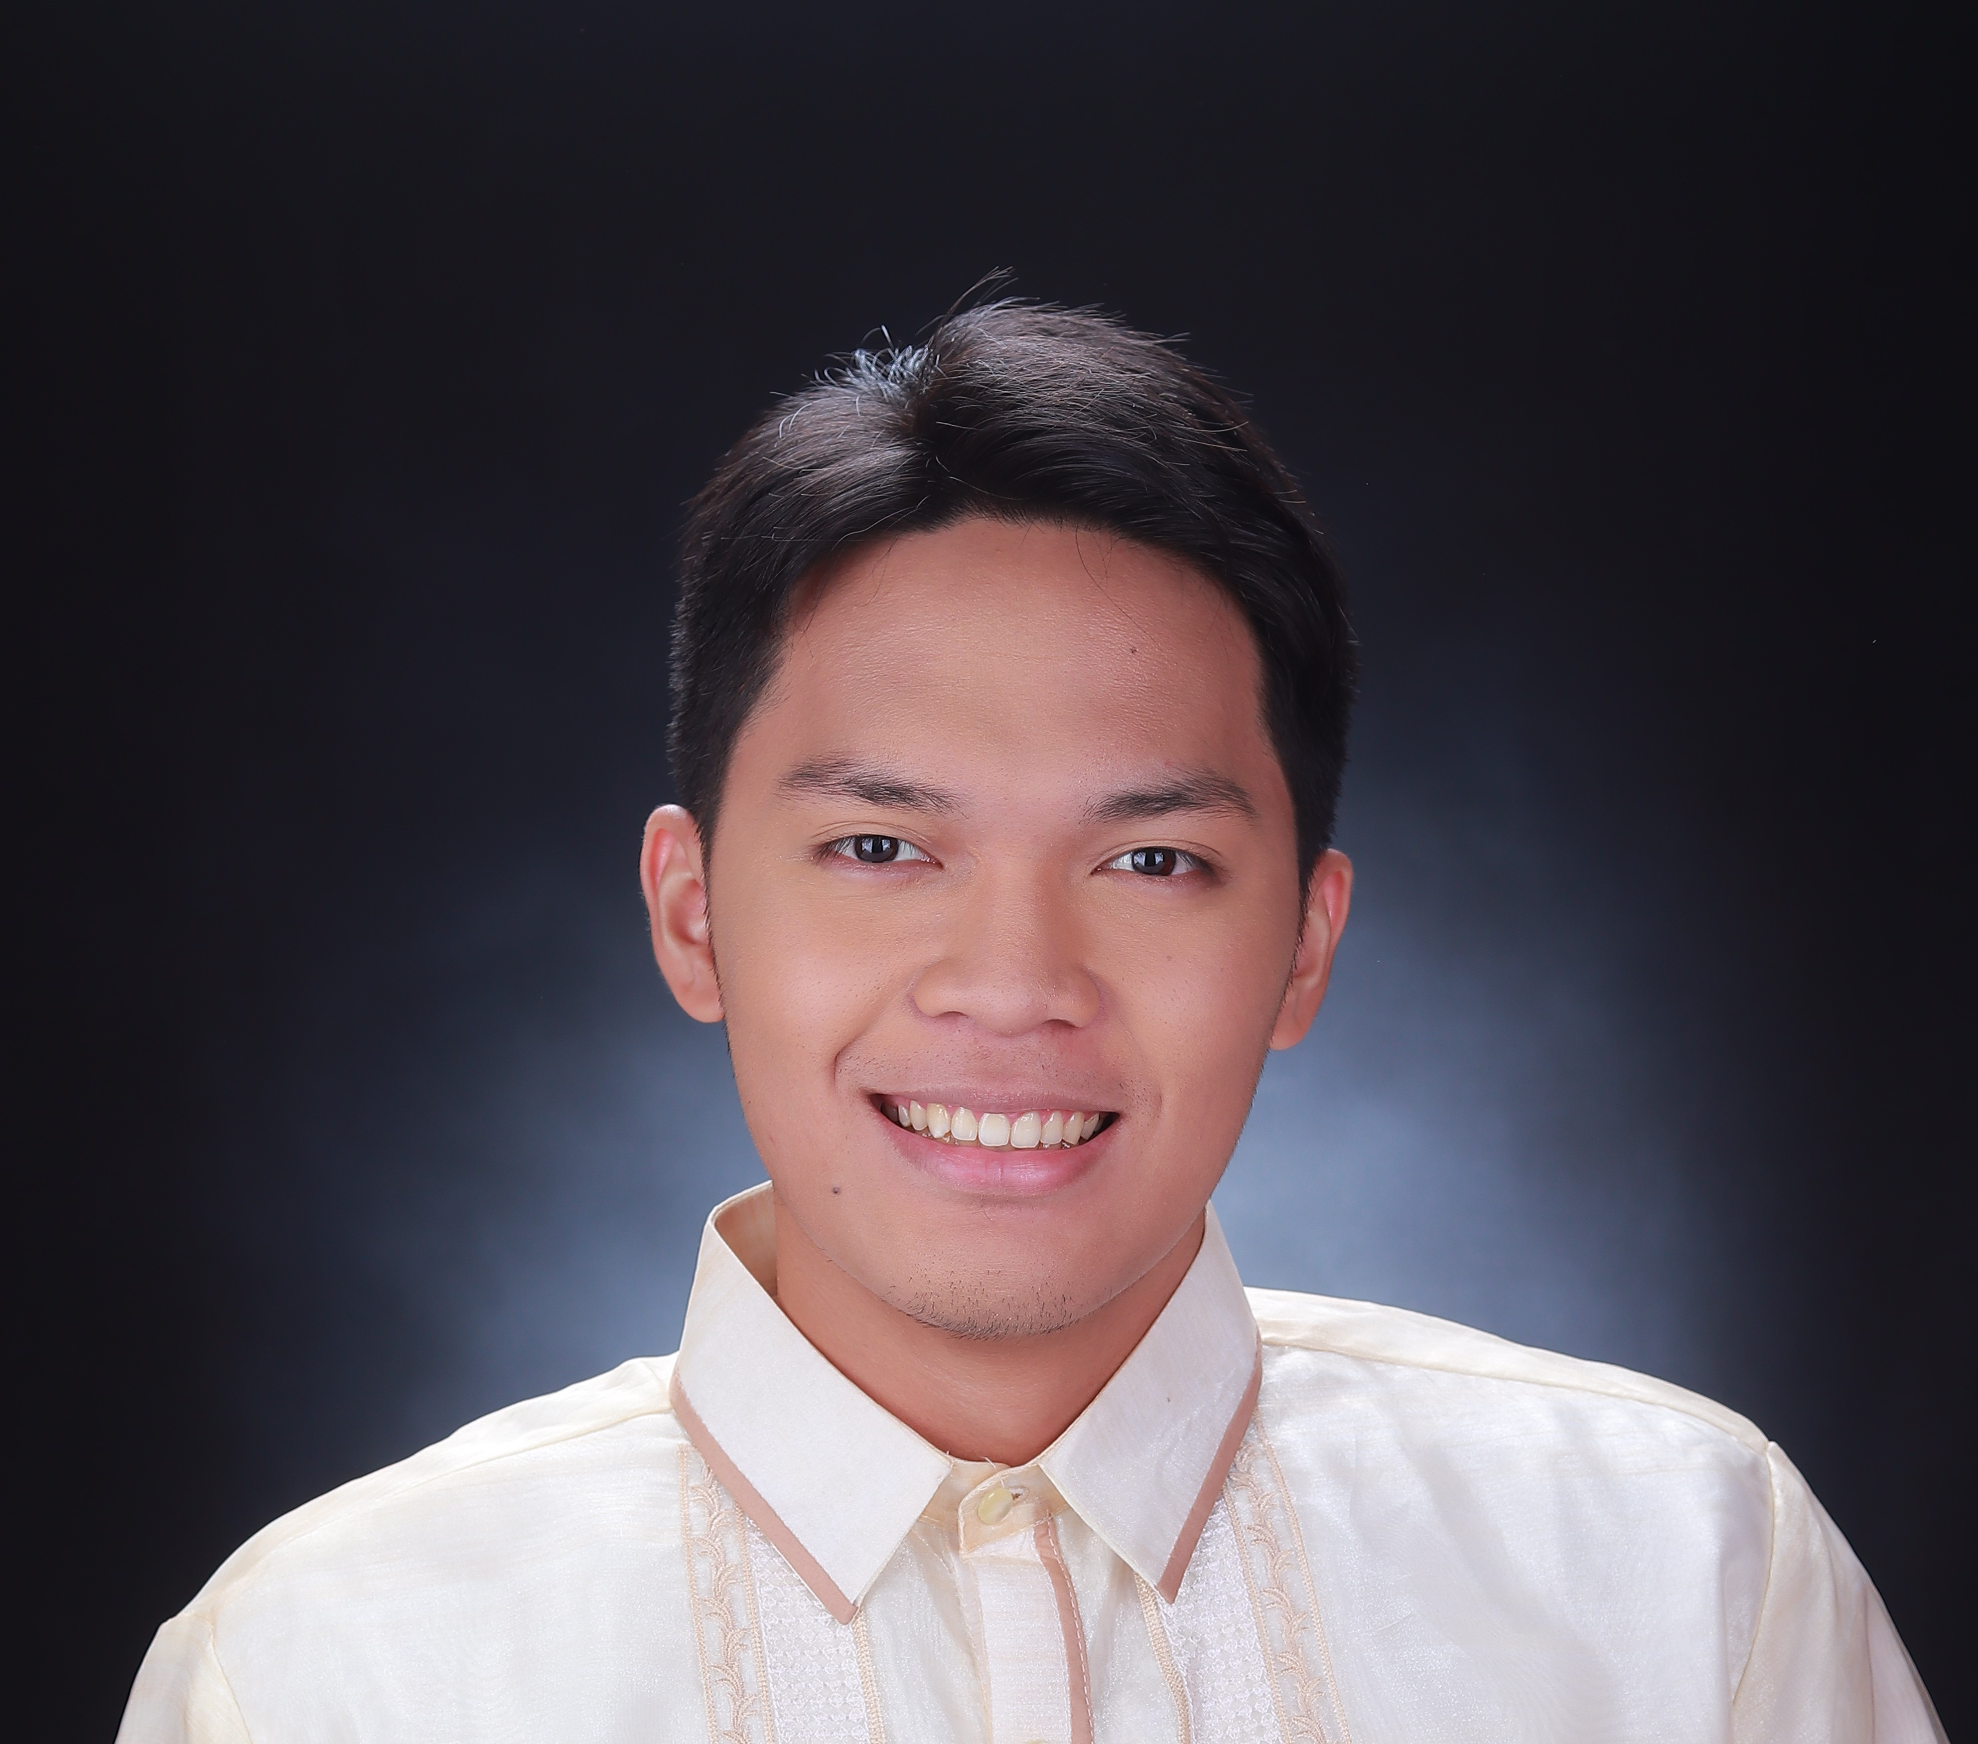
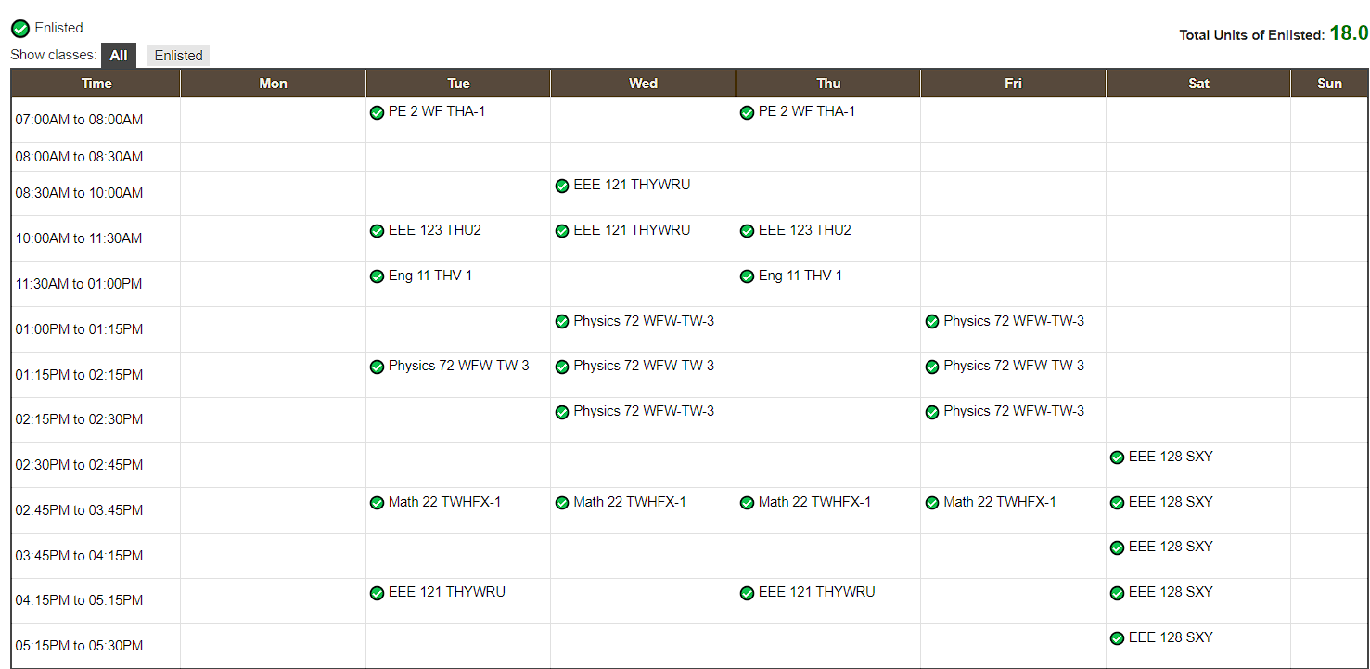
PERSONAL INFO
Name:
____Chauncie A. Favis__
Degree Program:
_____BS Electrical Engineering ____________
Contact Info:
E-mail: cafavis@up.edu.ph____
C#: ______09773834864________
PHOTO
CRS Schedule Screenshot
Chauncie
Person to contact in case of emergency:
_________Teresa Favis______________________
Contact Info:
___________09175762868____________
Address:
__________#4 baker St. Filinvest East Homes________________
Say something about yourself:
___I am excited to learn more about electrons and electricity_
Math and Physics grades in UP (if applicable)
Class | Instructor/s | Grade
Physics 71 | Sir Rodelas | 2.25
Math 21 | Ms. Raya | 2.50
I hereby conform with the Physics 72 Course guidelines by affixing my signature:
________________Chauncie Favis________________
(Signature over printed name)

